Slide 1
Kubernetes Explained
Session 2
Diego Casati, Cloud Solution Architect
Alice Gibbons, Cloud Native Global Black Belt

Slide 2


Who we are
Alice Gibbons
Technical Specialist
Cloud Native Global Black Belt Team
Calgary, Alberta
Diego Protta Casati
Cloud Solution Architect
One Commercial Partner Team
Calgary, Alberta

Slide 3
Kubernetes Explained: 3 Part Series
Session One
Session Two
Session Three
1
2
3
Sept 23, 1-4pm PDT
Docker & Kubernetes Basics
Sept 30, 1-4pm PDT
Azure Kubernetes Service deep dive, Helm & Secrets
Oct 7, 1-4 PDT
Day 2 Operations: Security Monitoring & Scaling
Notes:
Session 1 (Sept. 9)
Basics of containerization/orchestration
Introduction to AKS
Demo example cluster
Kubectl demo
Introduction to the Demo Example Scenario (usable across all 3 workshops)

Slide 4
Agenda
Quick Recap
Create a new AKS
Helm
Q&A
MS Learn Modules
Slides
https://github.com/guybarrette/k8sexplained

Slide 5
Quick Recap

Slide 6
What is a container?
Containers = operating system virtualization
Traditional virtual machines = hardware virtualization
OS
Application
VM
VM
VM
Applications
Container
Container
Container
App
App
App
Kernel
OS
OS
OS
OS
Hardware
Hardware

Slide 7
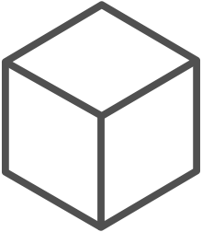
The container advantage
Fast iteration
Agile delivery
Immutability
Cost savings
Efficient deployment
Elastic bursting
For developers
For IT

Slide 8
The elements of orchestration
Scheduling
Affinity/anti-affinity
Health monitoring
Failover
Scaling
Networking
Service discovery
Coordinated app upgrades

Slide 9
Kubernetes: the industry leading orchestrator
Portable
Public, private, hybrid, multi-cloud
Extensible
Modular, pluggable, hookable, composable
Self-healing
Auto-placement, auto-restart, auto-replication, auto-scaling

Slide 10
Kubernetes 101
Internet
Kubernetes control
Worker node
Kubernetes users communicate with API server and apply desired state
kubelet
kube-proxy
Master node
Docker
Master nodes actively enforce desired state on worker nodes
Prod
Prod
API server
Containers
Containers
Worker nodes support communication between containers
-controller-manager
-scheduler
Worker node
kubelet
kube-proxy
Worker nodes support communication from the Internet
replication, namespace, serviceaccounts, etc.
etcd
Docker
Prod
Prod
Containers
Containers

Slide 11
Azure Kubernetes Service

Slide 12
AKS: Simplify the deployment, management, and operations of Kubernetes
Deploy and manage Kubernetes with ease
Accelerate containerized application development
Set up CI/CD in a few clicks
Secure your Kubernetes environment
Scale and run applications with confidence
Work how you want with open-source tools & APIs

Slide 13
How managed Kubernetes on Azure works
Automated upgrades, patches
High reliability, availability
Easy, secure cluster scaling
Self-healing
API server monitoring
At no charge
Azure managed control plane
App/ workload definition
Self-managed master node(s)
Kubernetes API endpoint
etcd Store
User
API server
Scheduler
Controller Manager
Cloud Controller
Schedule pods over private tunnel
Customer VMs
Docker
Docker
Docker
Docker
Docker
Pods
Pods
Pods
Pods
Pods

Slide 14


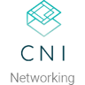



















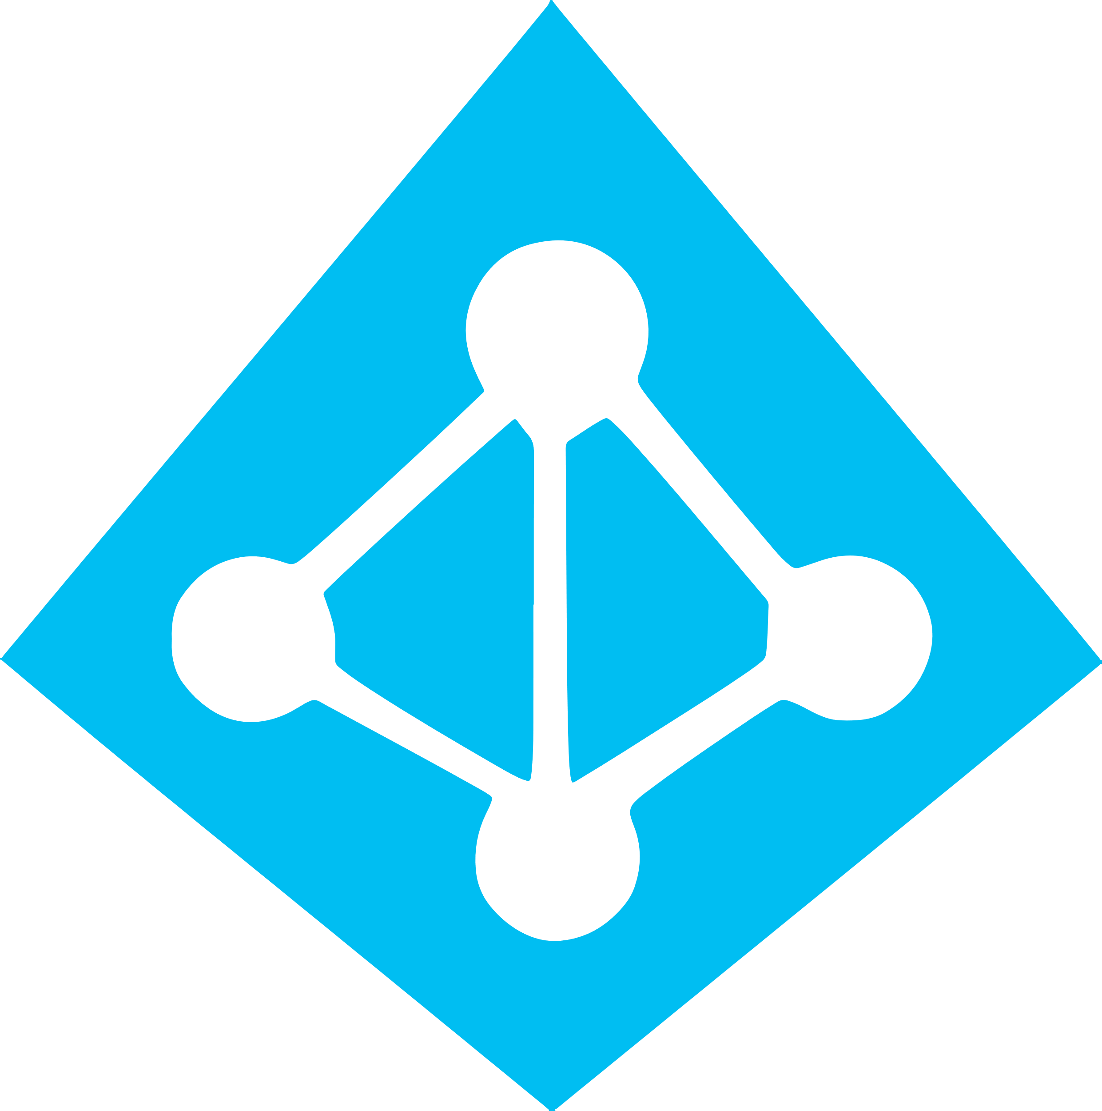
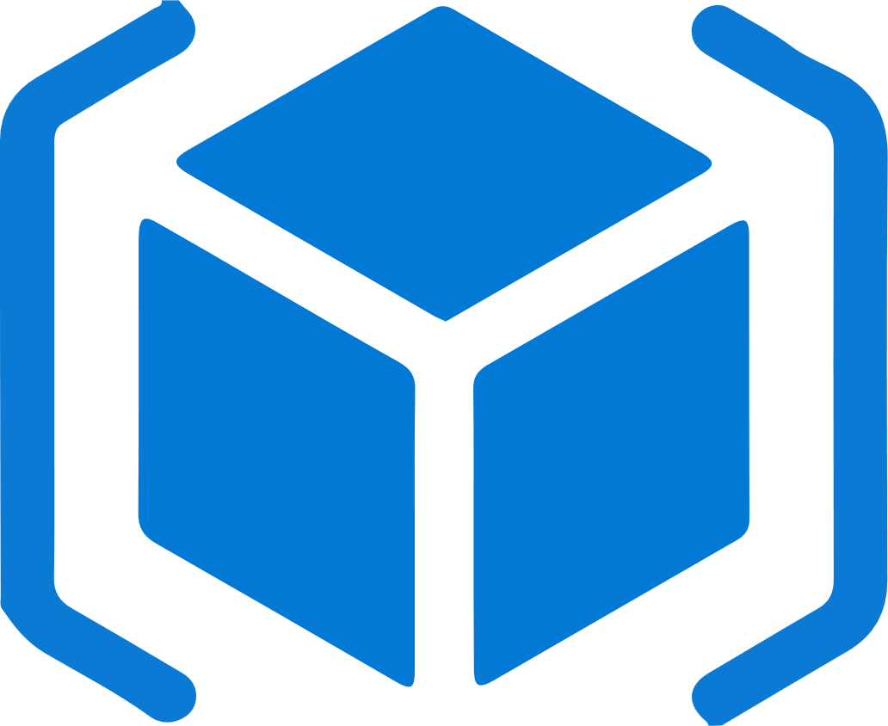

Work how you want with opensource tools and APIs
 | Development | DevOps | Monitoring | Networking | Storage | Security
Take advantage of services and tools in the Kubernetes ecosystem
OR, Leverage growing Azure support
RBAC
Azure Container Registry
AAD
Key Vault
VSTS
ARM
VS Code
Azure Monitor
Azure VNET
Azure Storage

Slide 15
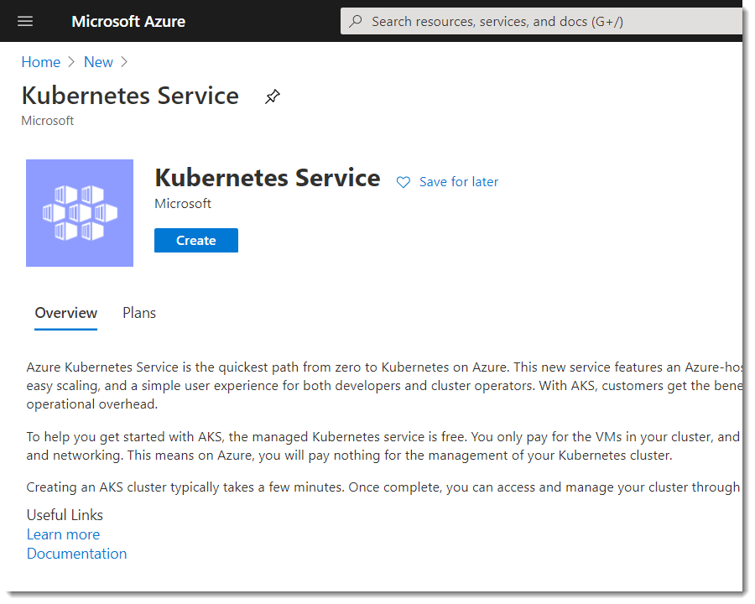

Slide 16
Getting Started with AKS – Start here
How do I create a cluster on Azure ?
az aks create -g myResourceGroup -n myCluster --generate-ssh-keys
How do I install the kubectl ?
az aks install-cli
How do I access my cluster?
$ az aks get-credentials -g myResourceGroup -n myCluster

Slide 17
Create a new AKS
Demo 1

Slide 18
Pods

Slide 19
pod
deployment
Kubernetes Resources
service
Replica set
ingress
Daemon set
job
namespace
Secret
Config-map

Slide 20
Kubernetes Resources: Pods
Zero to Many Containers Per Pod
Multi-Container Common Patterns:
Sidecar: Enhance or extend a container
Ambassador: Proxy network calls
Adapter: Transform output
Worker node
Container Runtime
Pod
Pod
Containers
Containers

Slide 21
Kubernetes Resources: Pods - Adapter Example
apiVersion: v1
kind: Pod
metadata:
labels:
run: sidecar-demo
name: sidecar-demo
spec:
containers:
- image: nginx
name: webserver
volumeMounts:
- mountPath: /var/log/nginx/
name: log-volume
resources: {}
- image: busybox
name: logaggregator
args: [/bin/sh, -c, 'tail -f /var/log/nginx/error.log>/var/log/nginx/nginx.errors']
volumeMounts:
- mountPath: /var/log/nginx/
name: log-volume
resources: {}
dnsPolicy: ClusterFirst
restartPolicy: Never
volumes:
- name: log-volume
emptyDir: {}
Worker node
Container Runtime
Pod
Pod
Containers
Containers

Slide 22
Deploy a Pod
Demo 2

Slide 23
Services

Slide 24
pod
deployment
Kubernetes Resources
service
Replica set
ingress
Daemon set
job
namespace
Secret
Config-map

Slide 25
Kubernetes Resources: Service
Provides Layer 4 Load Balancing
Types:
ClusterIP: Service is provided an IP internal to the cluster
NodePort: Allocates a port used to access the service across all nodes
LoadBalancer: Exposes the service via a cloud provider loadbalancer (ex. Azure internal or external LB)
ExternalName: Expose the service via cluster DNS mapping
Worker node
Deployment
ReplicaSet
Replicas: 4
ReplicaSet
Replicas: 2
Pods
Pods
Containers
Containers
Service
Service

Slide 26
Kubernetes Resources: Ingress
Provides Layer 7 Load Balancing
Kubernetes provides the basic API spec but third parties provide implementations, often adding features via Custom Resource Definitions
Common Ingress Controller Implementations
Nginx
Traefik
Gloo
Kong
Azure App Gateway
etc
Common Features:
SSL Offload
Routing (including Canary & A/B)
WAF
Worker node
Deployment
ReplicaSet
Replicas: 4
ReplicaSet
Replicas: 2
Pods
Pods
Containers
Containers
Service
Service
Ingress Controller

Slide 27
ClusterIP & Load Balancer
Demo 3

Slide 28
Config & Secrets

Slide 29
pod
deployment
Kubernetes Resources
service
Replica set
ingress
Daemon set
job
namespace
Secret
Config-map

Slide 30
Configs & Secrets
ConfigMaps
Secrets
Stored in etcd
Injected as environment variables
Secrets are stored as base64 strings
ConfigMaps / Secrets
definition
Self-managed master node(s)
Kubernetes API endpoint
etcd Store
User
API server
Scheduler
Controller Manager
Cloud Controller
Injected as environment variables
Customer VMs
Docker
Docker
Docker
Docker
Docker
Pods
Pods
Pods
Pods
Pods

Slide 31
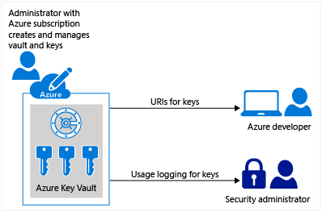
Azure Key Vault
Securely store and access secrets

Slide 32
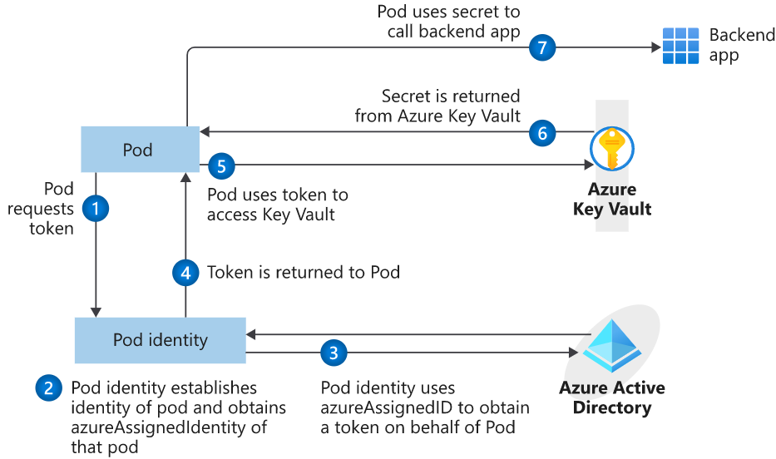
Azure Key Vault
Azure Key Vault provider for the Secrets Store CSI Driver
Secrets are stores in AKV
Pod Identity needs to be configured and access granted
Secret Store CSI Driver
Injects the secrets as standard K8s secrets mapped to files

Slide 33
ConfigMaps & Secrets
Demo 4

Slide 34
Helm

Slide 35
Helm
The best way to find, share, and use software built for Kubernetes
Manage complexity
Charts can describe complex apps; provide repeatable app installs, and serve as a single point of authority
Easy updates
Take the pain out of updates with in-place upgrades and custom hooks
Simple sharing
Charts are easy to version, share, and host on public or private servers
Rollbacks
Use helm rollback to roll back to an older version of a release with ease

Slide 36

Helm
Helm Charts helps you define, install, and upgrade even the most complex Kubernetes application
services
ci
db
load balancer
custom
…
Chart.yml

Slide 37
Deploy using Helm
Demo 5

Slide 38
Learning AKS

Slide 39
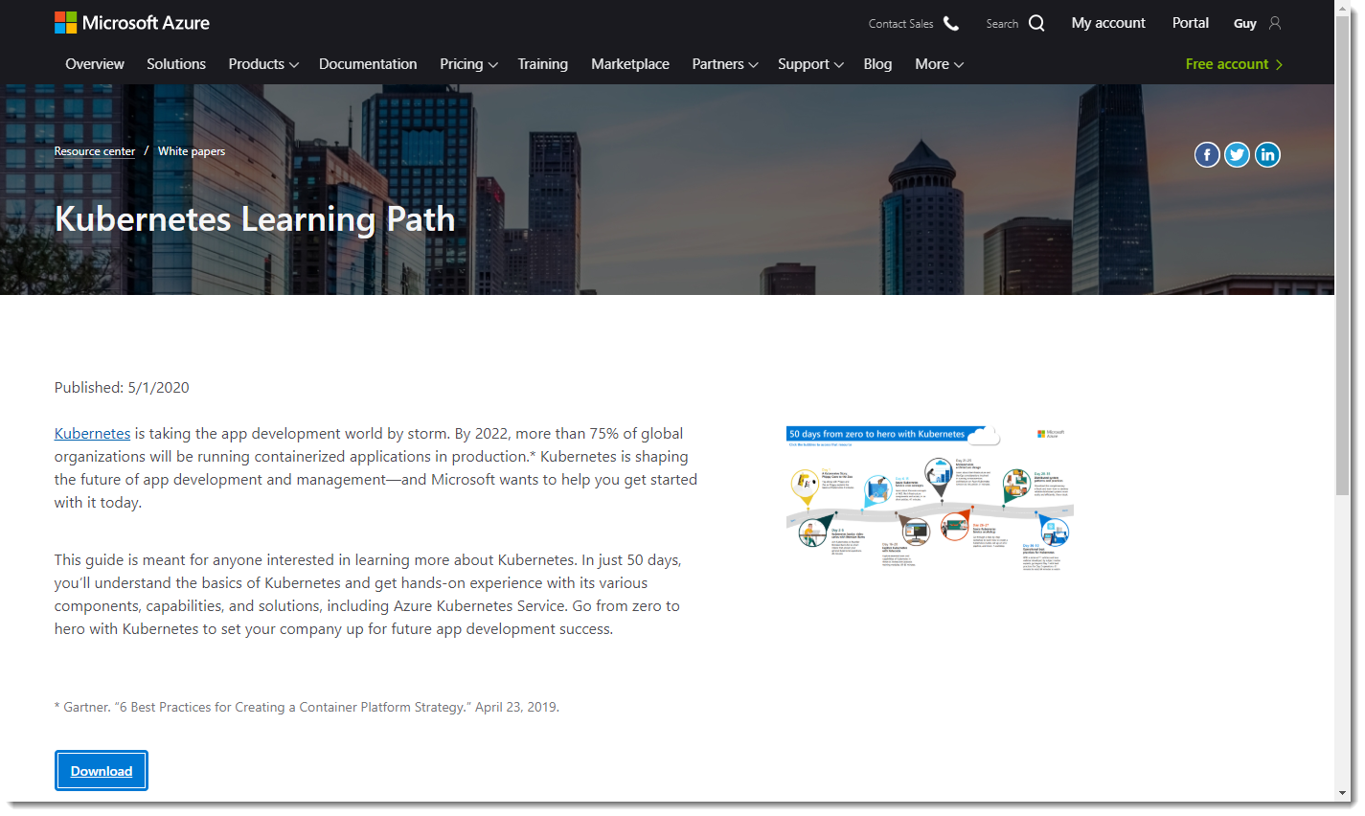
Learn Kubernetes
https://aka.ms/learnkubernetes

Slide 40
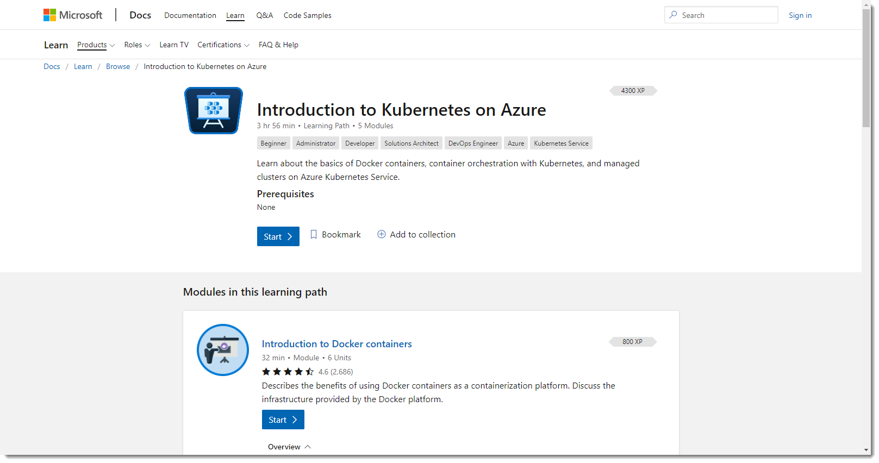
https://docs.microsoft.com/en-us/learn/paths/intro-to-kubernetes-on-azure/

Slide 41
Q&A

Slide 42
Thank You

